Slide 1
Comparative Analysis of CNN Models for Signature Verification
Aakash Bhattacharya
Aman Chopra
12/16/2021

Slide 2
Problem Definition
Classify a signature as genuine or forged based on the given input image
Offline signature verification
Compare different models with different hyperparameters and loss functions
CEDAR dataset
Notes:
Authenticity of an individual
Important to bifurcate b/w genuine and forged
Use cases in any type of paperwork like bank documents
Binary classification - classify an image as genuine or forged based on the given input image
Targeted offline verification - image given
Deploy and compare various models, state of the art as well as custom
Different hyperparameters and loss functions
Sigcomp2011, UTSig, CEDAR - final

Slide 3
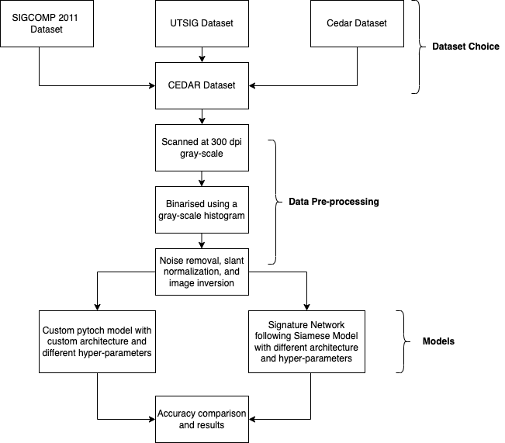
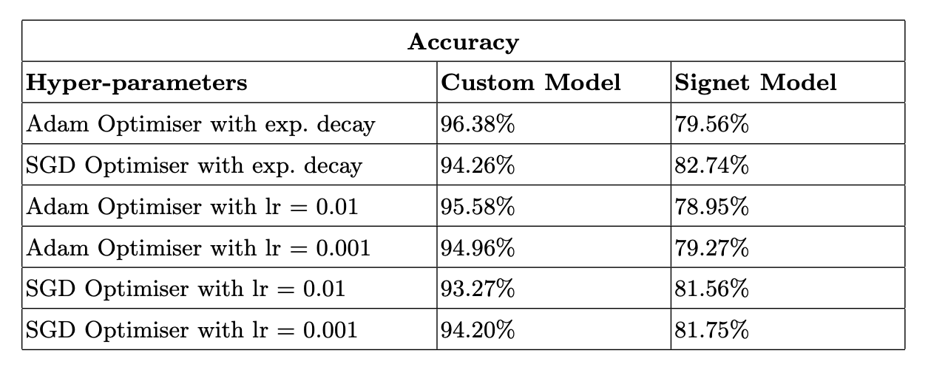
Results and Analysis
Notes:
Methodology explain
ConvNet and SigNet - siamese architecture
Adam and SGD optimisers with different learning rates and exponential decay
Convnet model - Adam and exponential decay - cross entropy loss - 96.38%
Signet model - SGD and exponential decay - contrastive loss - 82.74%
Siamese
Fewer images - better prediction
2 or more identical subnetworks
Parameter updating is mirrored too
Find similarity of inputs by comparing feature vectors
Works well with new data
More robust
Takes more time to train
ConvNet
Needs more data
Need to retrain if we have new data
Takes lesser time to train

Slide 4
Conclusion and Future Work
Compared and analyzed different models for signature verification
Tuned various hyperparameters for achieving a high accuracy
Various other deep networks can be tried for classification
Extend the work for online signature verification
Analyze the results on a larger dataset
Notes:
SigNet and ConvNet comparison
Hyperparam tuning and different loss functions
Future work
Try different deep nets like alexnet, vgg, resnet etc - more computing power
Extend this work to online signature verification where we can get the result as and when a signature is seen
Analyse the results on a larger dataset - few thousand samples currently - more data always helps

